Slide 1
Hand Written Character Recognition

Slide 2
Objectives
In our proposed work we will accept the challenges of recognizing words and we will work to win the challenge.
The handwritten document is scanned using a scanner.
The image of the scanned document is processed using the program.
Each character in the word is then isolated.
The individual isolated character is subjected to Feature by the Gabor Feature.
Extracted features are passed through Decision Tree classifier.
Finally we get the word recognised.

Slide 3
Requirements
Software Required
Python 3.7
Alphanumeric Datasets
Wamp Server
Hardware Required
PC (At least 3GB RAM with i3 Processor)
Mobile Camera Scanner Or simply Scanner

Slide 4



Flow Diagram
Input Image
Binary Image
Pre-Processing
Bounding Box
Segmentation
Gabor
Feature Extraction
Output Word
Decision Tree
Classification
Word Recognised

Slide 5
Image Processing
Pre-processing includes steps that are required to shape the input image into a form suitable for segmentation.
Color image is converted into gray scale .
Image transform into binary image that means in the form of black in white image.

Slide 6
Binarization
Image Binarization converts an image per frame upto 256 gray level to a black and white image.
The simplest way to use image binarization is to choose a threshold value and classify all pixels with values above the threshold as black and all other pixels are white.

Slide 7
Character Segmentation
To perform character segmentation, we need to scan each vertical pixel column starting from the left of word.
The characters are separated where we finds a column with no black pixels columns. This column acts as a separation between two character.

Slide 8
Classification (Decision Tree)

Slide 9
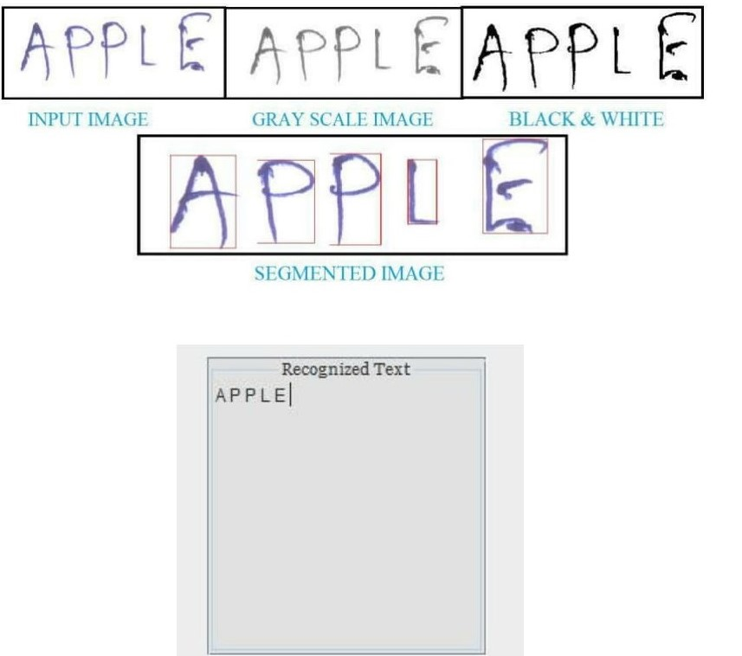
Rough Sketch

Slide 10
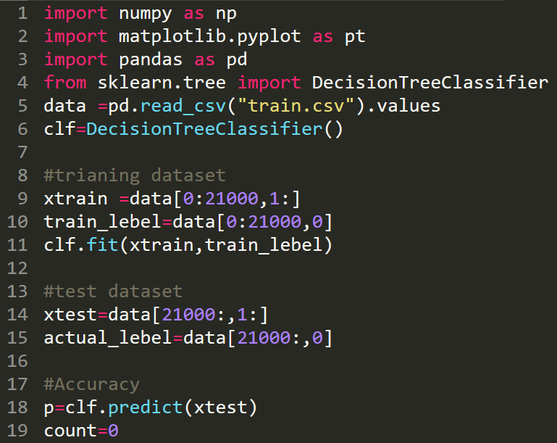
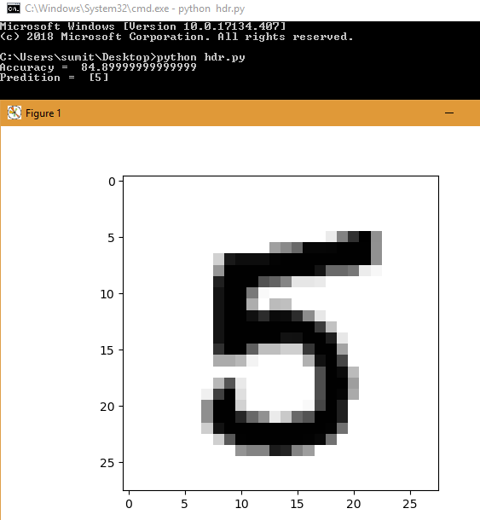
Screenshots
Codes
Output

Slide 11
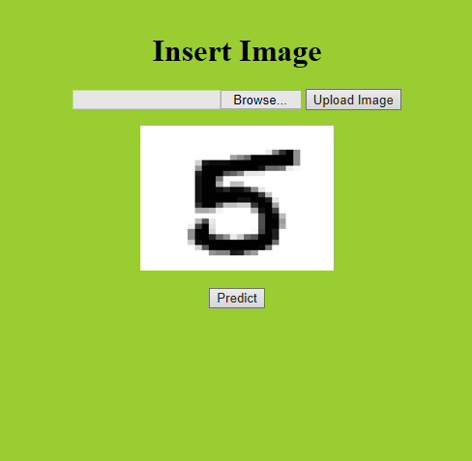
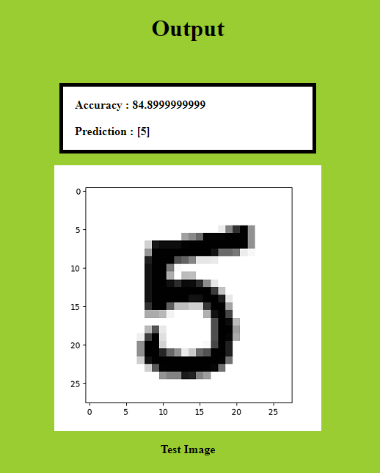
GUI

Slide 12
Mentor & Team
Guided & Motivated By
Prof. Piyal Sarkar
(IT HOD)
Working Team
Shrikant Kumar
Sumit Kr Trivedi
Shashikant Pathak
Vivek Kr Kushwaha

Slide 13
References
https://www.youtube.com/watch?v=uU1LHp-wFDQ
https://www.youtube.com/watch?v=aZsZrkIgan0
https://www.kaggle.com/c/digit-recognizer/data
https://scikit-learn.org/stable/

